Slide 1
Mapping ER-EER to Relational Model

Slide 2
Relational Model Review - Concepts
Relational Model is made up of tables
A row of table = a relational instance/tuple
A column of table = an attribute
A table = a schema/relation
Cardinality = number of rows
Degree = number of columns

Slide 3
Review - Example
Attribute
tuple/relational instance
Cardinality = 2
SID | Name | Major | GPA
1234 | John | CS | 2.8
5678 | Mary | EE | 3.6
4 Degree
A Schema / Relation

Slide 4
ER to Relational Mapping
How do we convert an ER diagram into a table?? Simple!!
Basic Ideas:
Build a table for each entity set
Build a table for each relationship set if necessary (more on this later)
Make a column in the table for each attribute in the entity set
Composite and Multivalue Attributes
Primary Key

Slide 5
ER\EER to Relational Mapping
ER-to-Relational Mapping Algorithm
Step 1: Mapping of Regular Entity Types
Step 2: Mapping of Weak Entity Types
Step 3: Mapping of Binary 1:1 Relationship Types
Step 4: Mapping of Binary 1:N Relationship Types
Step 5: Mapping of Binary M:N Relationship Types
Step 6: Mapping of Multivalued attributes
Step 7: Mapping of N-ary Relationship Types
Mapping EER Model Constructs to Relations
Step 8: Mapping of Specialization or Generalization
Step 9: Mapping of Union Types (Categories)

Slide 6
Mapping – Strong Entity Set
SID
Name
SSN
Name
Student
Advisor
Professor
Major
Dept
GPA
SID | Name | Major | GPA
1234 | John | CS | 2.8
5678 | Mary | EE | 3.6
SSN | Name | Dept
9999 | Smith | Math
8888 | Lee | CS

Slide 7
Mapping of Weak Entity
Weak Entity Set cannot exists alone
To build a table/schema for weak entity set
Construct a table with one column for each attribute in the weak entity
Add a column for the primary key of the Owner of the Weak Entity
Primary Key of the weak entity = Discriminator + foreign key

Slide 8
Mapping - Weak Entity Set
Age
SID
Name
Name
Student
owns
Children
Major
GPA
Mapping Rule
Construct a table with one column for each attribute in the weak entity
Add primary key of the Owner Entity in the table
Age | Name | SID
10 | Bart | 1234
8 | Lisa | 5678
* Primary key of Children is Parent_SID + Name

Slide 9
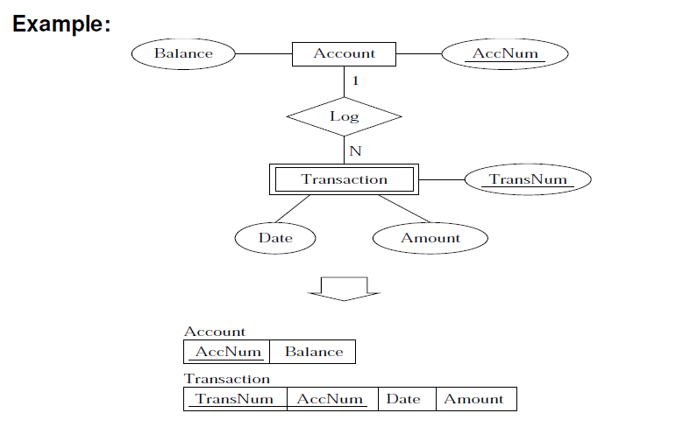
Mapping - Weak Entity Set

Slide 10
Mapping of Relationships
--This is a little complicated—
Unary/Binary Relationship set
Depends on the cardinality and participation constraints
N-ary (multiple) Relationship set
Identifying Relationship

Slide 11
Mapping Relationship Set Unary/Binary Relationship
1-1 relationship without total participation
Relationship relation: Build a table and add columns for each participating entity’s primary key. Also add the attributes of the relationship. (cross-reference)
1-1 relationship with one total participation
Foreign key approach: Add primary key of the entity without total participation in the table of the entity with total participation.
Merged relation (alternate mapping): merge the two entities and the relationship into a single relation (used when both participations are total).

Slide 12
Example: Relationship Relation
Date
SID
Name
S\N #
1
1
Student
Assigned
Laptop
Major
Major
GPA
Brand
SID | S\N# | Date
9999 | 07 | 12-08-09
8888 | 05 | 15-07-10
* Primary key can be either SID or S\N#

Slide 13
Example: Foreign Key Approach
Date
SID
Name
S\N #
1
1
Student
Assigned
Laptop
Major
Major
GPA
Brand
SID | Name | GPA | Major | S\N# | Date
9999 | Bart | 3.2 | 1 | 11289 | 12-09-09
8888 | Lisa | 4.0 | 2 | 12345 | 14-02-10

Slide 14
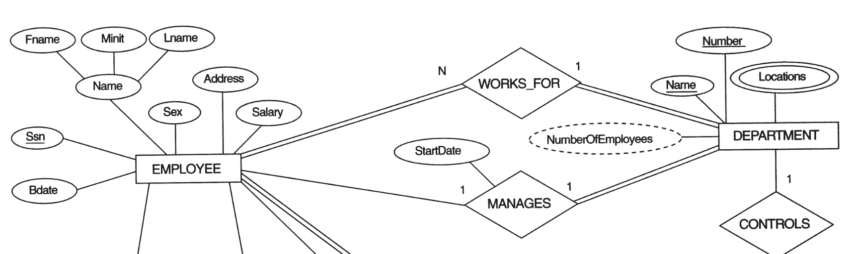
FIGURE 7.1 The ER conceptual schema diagram for the COMPANY database.

Slide 15
Representing Relationship Set Unary/Binary Relationship
1-N relationship without total participation
Same as 1-1 relationship
Relationship relation: Build a table and add columns for each participating entity’s primary key. Also add the attributes of the relationship. (cross-reference)
1-N with total participation on N side
Foreign key approach : Add a column in the table of the entity on the N side, put in there the primary key of the entity on the 1 side.

Slide 16
Example – 1:N Relationship Set
Semester
SID
Name
SSN
N
1
Student
Advisor
Professor
Major
GPA
Dept
Name
SID | Name | Major | GPA | Pro_SSN | Ad_Sem
9999 | Ali | EE | 3.0 | 123-456 | Fall 2009
8888 | Aliya | CS | 3.8 | 567-890 | Fall 2008
* Primary key of this table is SID

Slide 17

FIGURE 7.1 The ER conceptual schema diagram for the COMPANY database.

Slide 18
Representing Relationship Set Unary/Binary Relationship
N:M relationship
Relationship relation: Build a table and add columns for each participating entity’s primary key. Also add the attributes of the relationship. (cross-reference)
Primary key of this new table is the union of the foreign keys of both entity sets.
Note No Foreign Key approach is possible…

Slide 19
FIGURE 7.1 The ER conceptual schema diagram for the COMPANY database.

Slide 20
Representing Relationship Set N-ary Relationship
Intuitively Simple
Build a new table, add primary keys of all participating entity sets.
Add attributes of the relationship set
The primary key of this new table is the union of all primary keys of entities that are on N side
That is it, we are done.

Slide 21
Example – N-ary Relationship Set
P-Key1
D-Attribute
A-Key
E-Set 1
N
P-Key2
N
1
relationship
Another Set
E-Set 2
N
P-Key3
E-Set 3
P-Key1 | P-Key2 | P-Key3 | A-Key | D-Attribute
9999 | 8888 | 7777 | 6666 | Yes
1234 | 5678 | 9012 | 3456 | No
* Primary key of this table is P-Key1 + P-Key2 + P-Key3

Slide 22
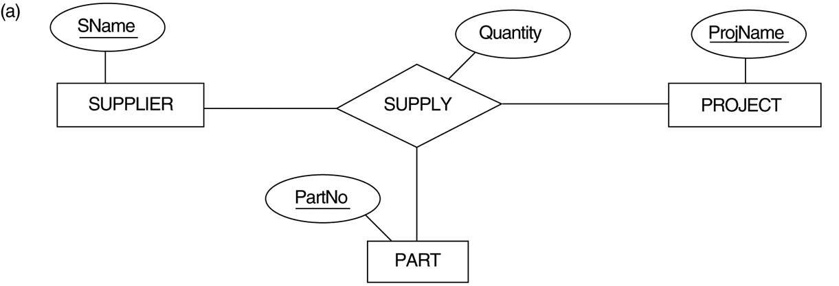
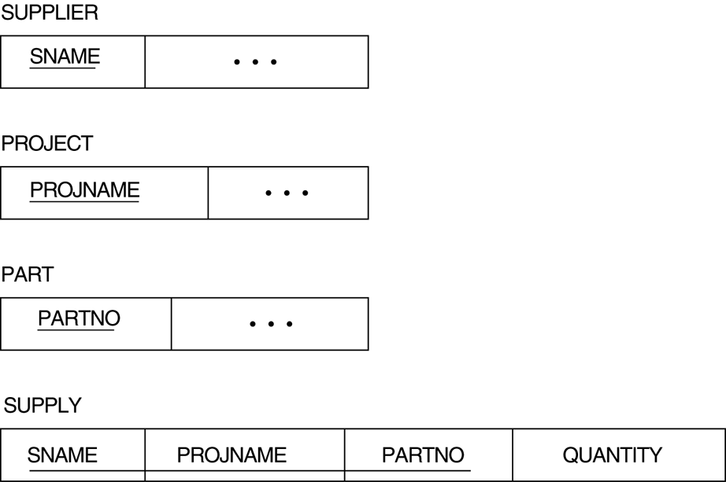
FIGURE 4.11 Ternary relationship types. (a) The SUPPLY relationship.

Slide 23
Representing Relationship Set Identifying Relationship
Don't create a table for the identifying relationship
As we have built a table for the corresponding weak entity
Reason:
A special case of 1:N with total participation
Reduce Redundancy

Slide 24
Representing Composite Attribute
One column for each component attribute
NO column for the composite attribute itself
SSN
Name
SSN | Name | Street | City
9999 | Dr. Smith | 50 1st St. | Fake City
8888 | Dr. Lee | 1 B St. | San Jose
Professor
Address
Street
City

Slide 25
Representing Multivalue Attribute
Build a new relation schema with two columns
Add the primary keys of the entity/relationship that has the multivalue attribute
Add the multivalue attribute.
Each cell of this column holds only one value. So each value is represented as an unique tuple
Primary key for this schema is the union of all attributes

Slide 26
Example – Multivalue attribute
SID
Name
The primary key for this table is Student_SID + Degree, the union of all attributes
Degree
Student
Major
GPA
Stud_SID | Degree
1234 | FSC
1234 | BS
5678 | BS
5678 | MS
5678 | FA
SID | Name | Major | GPA
1234 | Javed | CS | 2.8
5678 | Saif | EE | 3.6

Slide 27

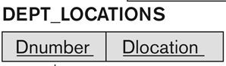
Example – Multivalue attribute

Slide 28
Correspondence between ER Model & Relational Model
ER Model
Relational Model
Entity type
1:1 or 1:N relationship type
M:N relationship type
n-ary relationship type
Simple attribute
Composite attribute
Multivalued attribute
Value set
Key attribute
Entity relation
Foreign key (or relationship relation)
Relationship relation and two foreign keys
Relationship relation and n foreign keys
Attribute
Set of simple component attributes
Relation and foreign key
Domain
Primary (or secondary) key

Slide 29
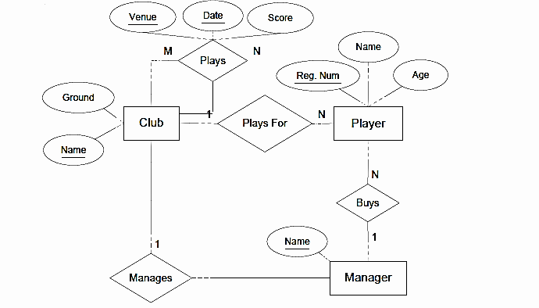
ER to Relational: Example Football Club
“A football club has a name and a ground and is made up of players. A player can play for only one club. A manager, represented by his name manages a club. A footballer has a registration number, name and age. A club manager also buys players. Each club plays against other clubs in the league and matches have a date, venue and score.”

Slide 30
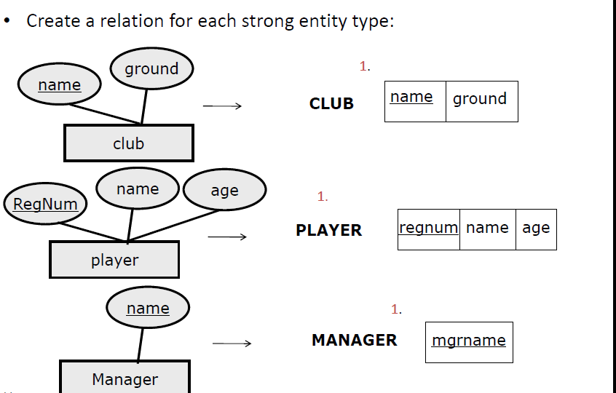
Example Step1

Slide 31
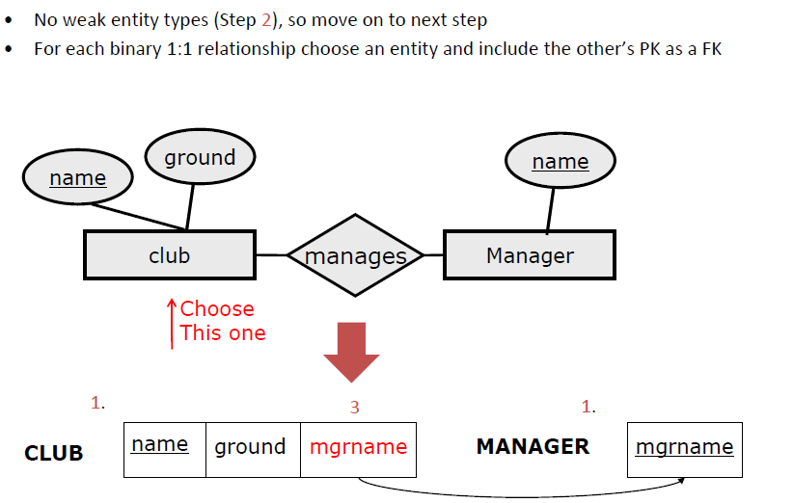
Example Step 2 &3

Slide 32
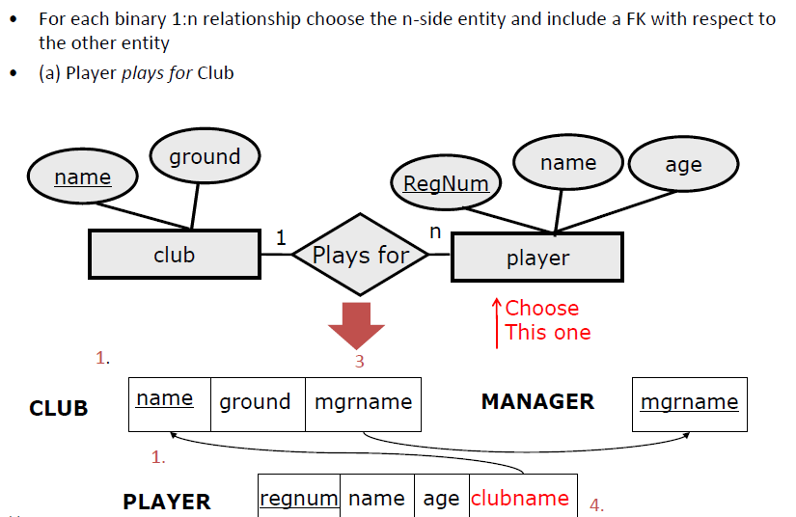
Example Step 4

Slide 33
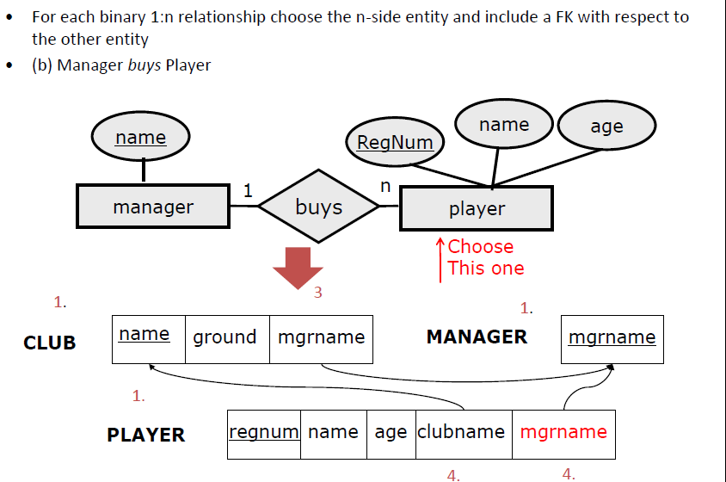
Example Step 4

Slide 34
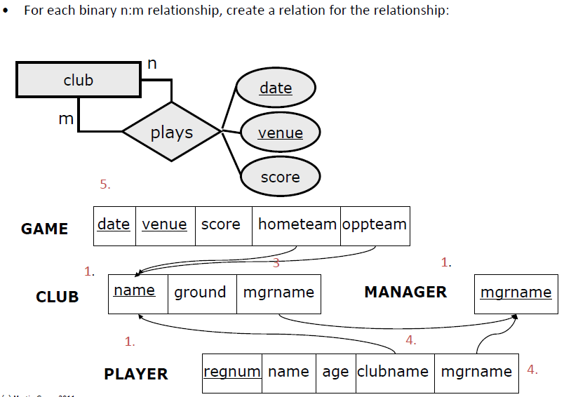
Example Step 5

Slide 35
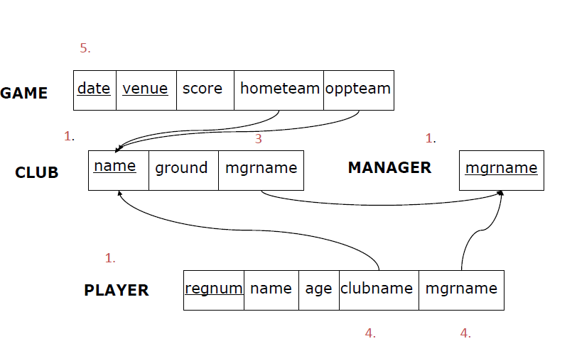
Example – Final Relation

Slide 36
Correspondence between ER Model & Relational Model
ER Model
Relational Model
Entity type
1:1 or 1:N relationship type
M:N relationship type
n-ary relationship type
Simple attribute
Composite attribute
Multivalued attribute
Value set
Key attribute
Entity relation
Foreign key (or relationship relation)
Relationship relation and two foreign keys
Relationship relation and n foreign keys
Attribute
Set of simple component attributes
Relation and foreign key
Domain
Primary (or secondary) key

Slide 37
Mapping EER Model Constructs to Relations
For Mapping Specialization or Generalization we have four options:
Multiple relations-Superclass and subclasses
Multiple relations-Subclass relations only
Single relation with one type attribute
Single relation with multiple type attributes

Slide 38
Mapping EER Model Constructs to Relations
Multiple relations- Superclass and Subclasses
Create a relation for the Superclass
Create a relation for each subclass and also include the primary key of the Superclass
This option works for any specialization (total or partial, disjoint or over-lapping).

Slide 39
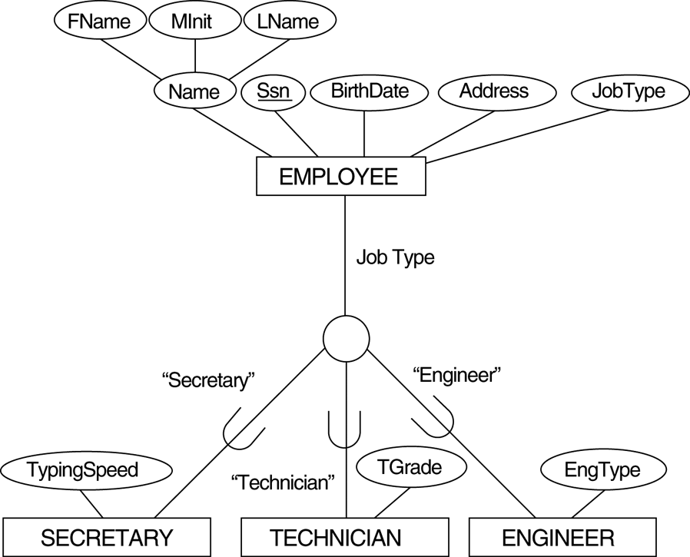
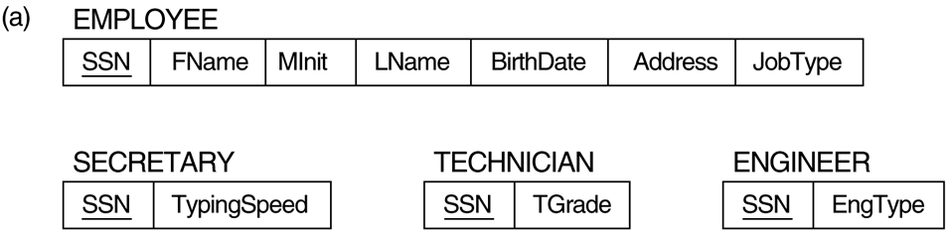
Attribute-defined specialization on JobType

Slide 40
Mapping EER Model Constructs to Relations
Multiple Relations-Subclass relations only
Create a relation for each subclass and include the attributes of the superclass in each subclass relation
This option only works for a specialization whose subclasses are total
Every entity in the superclass must belong to at least one of the subclasses.
It is preferred that subclasses are disjoint (to avoid redundancy)
Need Outer join (or full outer join) to get all entities

Slide 41
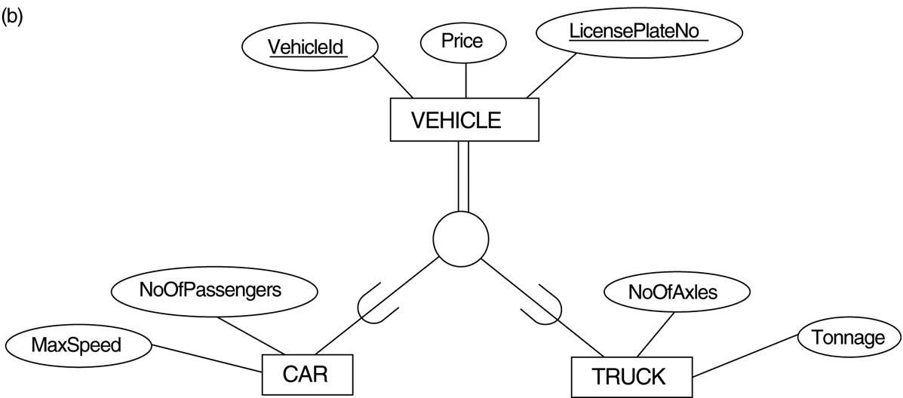
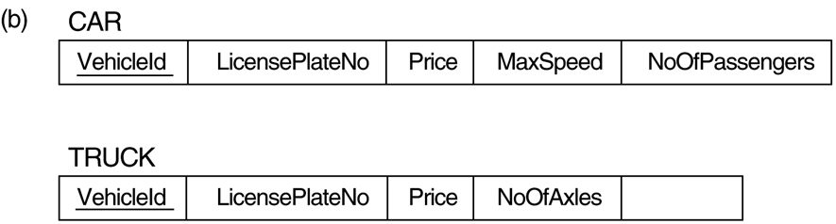
Generalizing CAR and TRUCK into the superclass VEHICLE.
Tonnage

Slide 42
Mapping EER Model Constructs to Relations
Single relation with one type attribute
Create a single relation for superclass and all of the subclasses
The new relation includes the attributes of superclass and all the attributes of each subclass
The relation also includes an attribute that indicates the subclass to which each tuple belongs
Not recommended if subclasses have many attributes
This option works only for a specialization whose subclasses are disjoint,
Notes:
Not possile for overlpping
It can generate many NULL values if many specific attributes exist in the subclasses.

Slide 43
Attribute-defined specialization on JobType
EngType
Notes:
Not possible for overlapping relations

Slide 44
Mapping EER Model Constructs to Relations
Single relation with multiple type attributes
Create a single relation for superclass and all of the subclasses
The new relation includes the attributes of superclass and all the attributes of each subclass
The relation also includes m type attributes, that is {t₁, t₂,…,t_{m}}, where m is the no of subclasses.
Each t_{i}, 1 < i < m, is a Boolean type attribute indicating whether a tuple belongs to the i^{th} subclass.
This option is for overlapping subclasses (but will work for a disjoint subclasses).

Slide 45
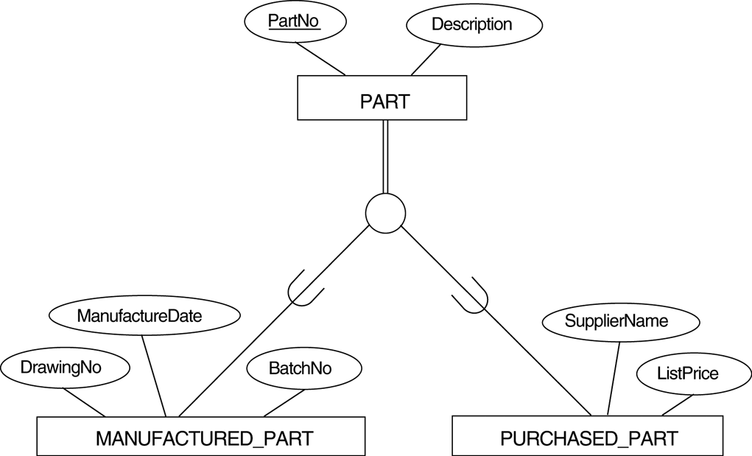
FIGURE 4.5 EER diagram notation for an overlapping specialization.
O

Slide 46
Mapping of Shared Subclasses (Multiple Inheritance)
A shared subclass, is a subclass of several classes, indicating multiple inheritance.
These classes must all have the same key attribute. WHY ?
Otherwise, the shared subclass would be modeled as a category.
We can apply any of the options discussed before for Specialization\Generalization to a shared subclass, subject to the restriction.
Notes:
A shared subclass, such as STUDENT_ASSISTANT, is a subclass of several classes, indicating multiple inheritance. These classes must all have the same key attribute; otherwise, the shared subclass would be modeled as a category.

Slide 47
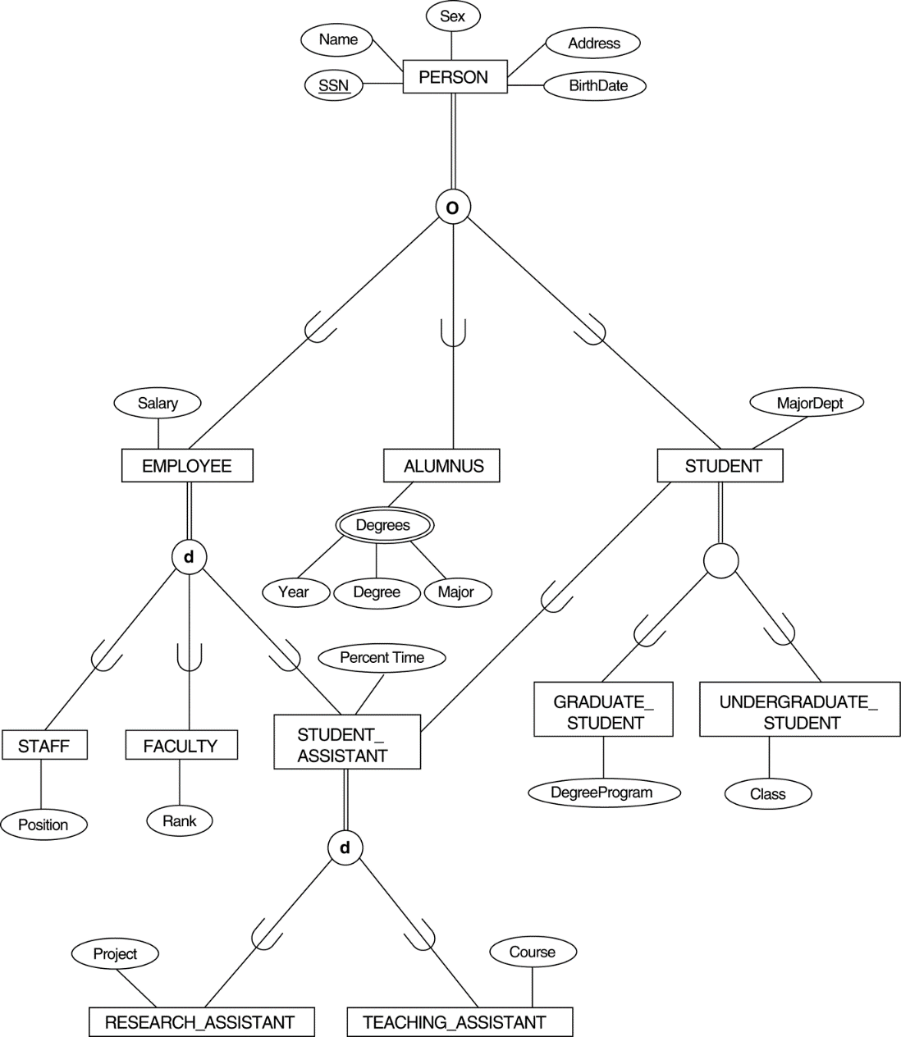
FIGURE 4.7 A specialization lattice with multiple inheritance for a UNIVERSITY database.

Slide 48
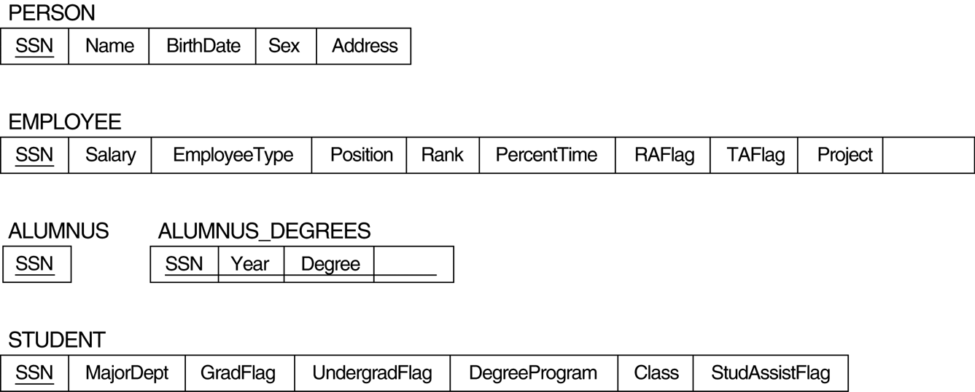
FIGURE 7.5 Mapping the EER specialization lattice in Figure 4.6 using multiple options.

Slide 49
Mapping of Union Types (Categories)
For mapping a category whose superclass have different keys, we specify a new key attribute, called a surrogate key.

Slide 50
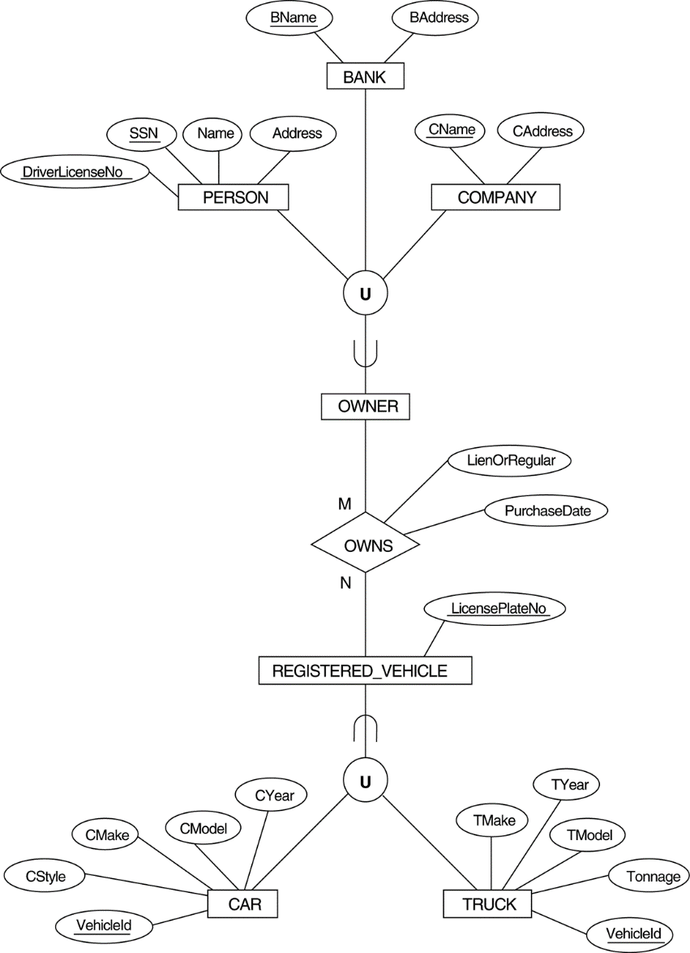
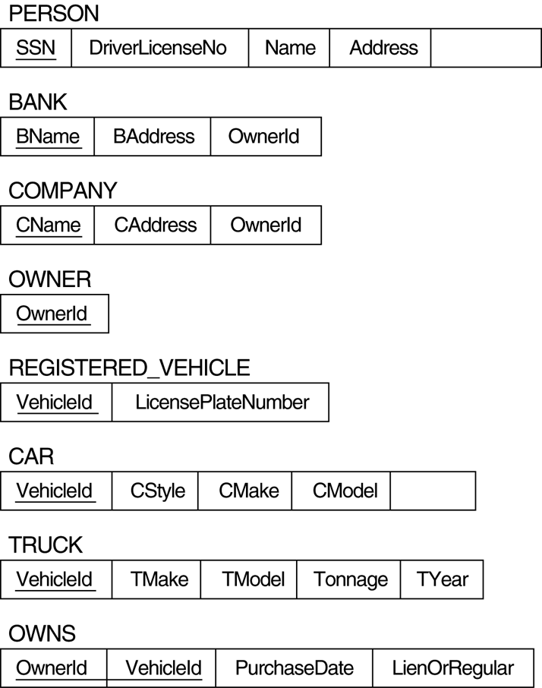
FIGURE 4.8 Two categories (union types): OWNER and REGISTERED_VEHICLE.
OwnerId
Notes:
In the example below we can create a relation OWNER to correspond to the OWNER category and include any attributes of the category in this relation. The primary key of the OWNER relation is the surrogate key, which we called OwnerId

Slide 51
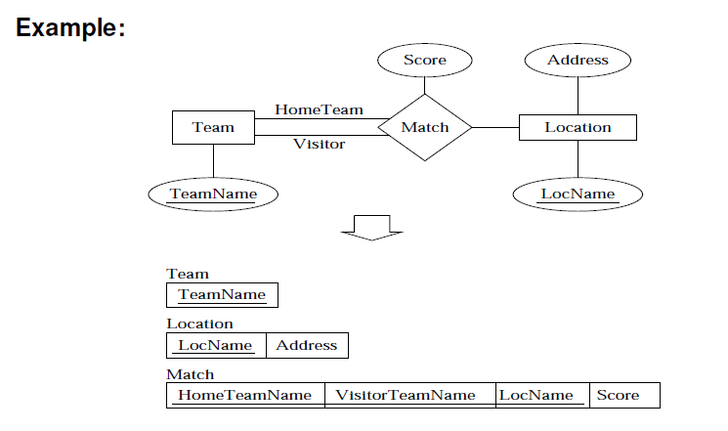
Mapping Exercise 1

Slide 52
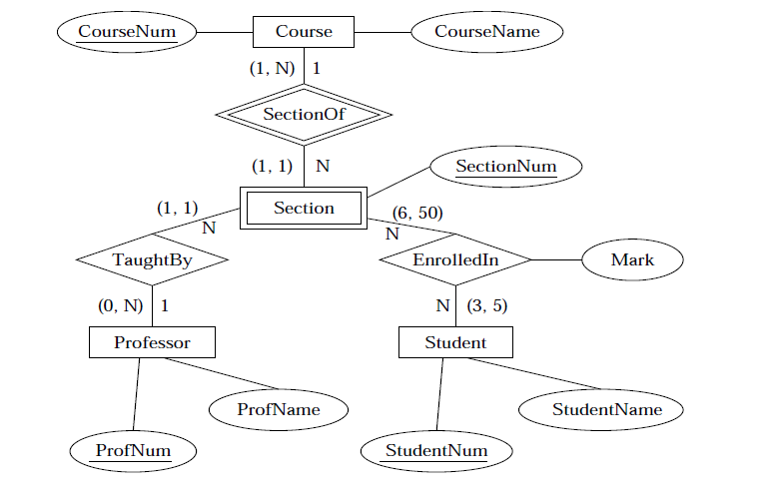
Mapping Exercise 2

Slide 53
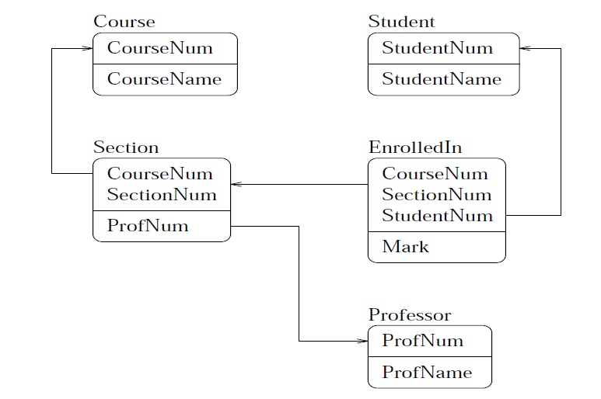
Mapping Exercise 2 -RESULT

Slide 54
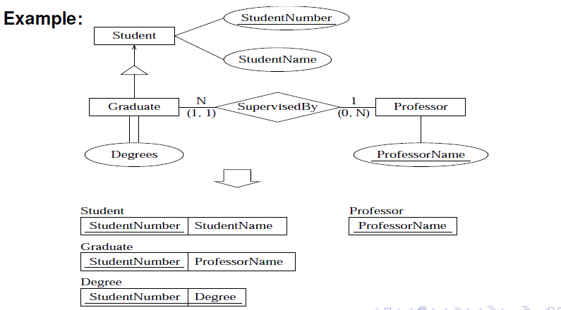
Specialization Mapping Example

